Slide 1
HTML5 APIs for the mobile
& Web Hosting 101
Stepping into the real world
Useful HTML5 APIs + Hosting

Slide 2
HTML5 APIs for Mobile
There are many new HTML5 APIs for the mobile devices that are being constantly developed and used. Some gain popularity, while others may not be used, or is eventually removed. Here is a list of some of the most updated ones available right now:
https://github.com/AurelioDeRosa/HTML5-API-demos
Click on Specifications to see the full w3c specifications
In the next couple of slides, we will go through some of the more useful ones, pointing to you reference sites on how to implement them, as well as browser support and demos. So, get ready your mobile phone to access the demo and see the effects yourself.

Slide 3
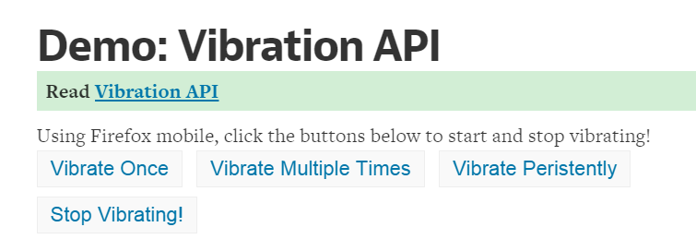
IT1322 – Principles of Web Usability Design
his API offers detailed timing information throughout the page load process accessible through thetiming property of the window.performance object. In detail, it provides measurements related to page redirects, DNS lookup, time spent building the DOM, TCP connection establishment, and several other metrics.
Vibration API
Wouldn’t it be great if you could use vibration in your application?…
Walking directions could be indicated using one vibration for left, two for right.
The phone could vibrate in a certain way when an event occurs or you’re close to someone.
You could send secret messages in vibration-based morse code!
A game could be enhanced by vibrating when you crash or are hit by a missile.
Reference: http://davidwalsh.name/vibration-api
Demo:http://davidwalsh.name/demo/vibrate.php (Access using mobile phone)
Support: Moderate, see: http://caniuse.com/#feat=vibration

Slide 4
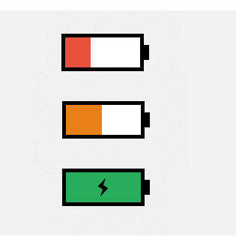
IT1322 – Principles of Web Usability Design
Battery Status API
This API allows you to inspect the state of a device’s battery and fires events about changes in battery level or status.
Reference:http://www.hongkiat.com/blog/html5-battery-status/
Demo (Try access via your mobile phone now☺)
http://demo.hongkiat.com/html5-battery-status/
Support:Moderate.See:
http://caniuse.com/#feat=battery-status

Slide 5
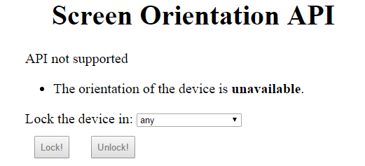
IT1322 – Principles of Web Usability Design
Screen Orientation API
This API allows you to inspect the state of a device’s battery and fires events about changes in battery level or status.
Reference:http://www.sitepoint.com/introducing-screen-orientation-api/
Demo (Try access via your mobile phone now☺)
http://aurelio.audero.it/demo/screen-orientation-api-demo.html
Support:Moderate.See:
http://caniuse.com/#feat=screen-orientation

Slide 6
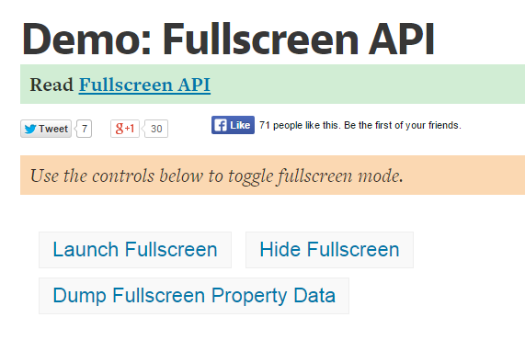
Full Screen API
The FullScreen provides a way to request fullscreen display from the user, and exit this mode when desired.
Reference:http://davidwalsh.name/fullscreen
Demo (Try access via your mobile phone now☺)
http://davidwalsh.name/demo/fullscreen.php
Support:Most browsers

Slide 7
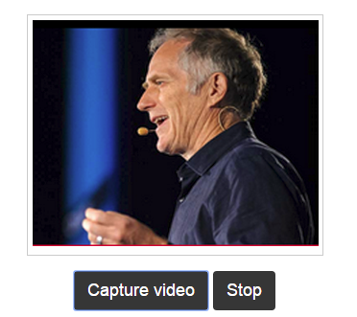
Getusermedia API (Camera API)
The getUserMedia API provides access to multimedia streams (video, audio, or both) from local devices. There are several use cases for this API. The first one is obviously real-time communication, but we can also employ it to record tutorials or lessons for online courses. Another interesting use case is the surveillance of your home or workplace. On its own, this API is only capable of acquiring audio and video, not sending the data or storing it in a file.
Reference:
http://www.html5rocks.com/en/tutorials/getusermedia/intro/
http://davidwalsh.name/browser-camera
Demo (Try access via your mobile phone now☺)
http://davidwalsh.name/demo/camera.php
More DEMOS (capturing camera or video, applying filters to video, audio capturing)
http://www.html5rocks.com/en/tutorials/getusermedia/intro/
Convertingimage to jpeg:
http://davidwalsh.name/demo/convert-canvas-image.php
Support:Most browsers

Slide 8

HTML5 Geolocation API
In many cases, obtaining user location would be extremely useful to establish better user experience, for example:
E-commerce sites can immediately provide shipping cost estimation and inform product availability from local retailers
News sites can provide localized headlines and weather report.
Daily deal sites can provide offers and discounts available from user’s local stores or restaurants.
Movie sites can listed the ‘Now Playing’ movies in nearby theatres,
In the following demo, the creator use the API to create a set of functions to retrieve user’s location and show it in map with Google Maps.
Reference:http://www.hongkiat.com/blog/html5-geolocation/
Demo (Try access via your mobile phone now☺)
http://demo.hongkiat.com/html5-geolocation/
Support:Most browsers

Slide 9
IT1322 – Principles of Web Usability Design
Navigation Timing API
Page load time is one of the most important aspects of the user experience.
This API offers detailed timing information throughout the page load process accessible through the timing property of the window.performance object.
The Navigation Timing API is currently supported in IE9+, Firefox 7+, Opera 15+, and Chrome 6+.

Slide 10
How can I use them?
Now that you have access to some of the APIs, think of how you can use them in your mobile web application?
Cam to monitor your child ?
Attendance taking with photos?
Display layout based on screen orientation?
Vibration notification for certain interactions?
Recommend user of the cinema nearest to him or her?
To test out these amazing features on your web application, it is recommended that you need sign up to a web hosting site. Here’s how.

Slide 11
Web Site Hosting
Get started and own your first website

Slide 12
Hosting your site – Free or Paid?
At your own free time, understand web hosting through a series of videos on youtube. Eg,
https://www.youtube.com/watch?v=PCMT6q89kZA
Free Hosting – Plenty out there, but slow in performance
Paid Hosting
  ehost (USD$7 for one month only) or (for USD$60 for one year)
  http://ehost.com
  HostGator.sg (SGD$8 a month) https://www.hostgator.sg/

Slide 13
Hosting 101 – What makes a good host?
Choose a good site.
  Free domain names (www.whatyouwant.com as many as you can get)
  As many subdomains hosted (customized web addresses that allow you to create multiple pages for each site. >25 per website is good.
  Free email address ( to help manage business operations, user feedbacks)
  Free marketing tools – google Adwords, affiliate programmes
  Easy to use site builder
  Cheap yearly rates
  Large disk space
  Offer MySQL databases, php support, client scripts support
  Wordpress compatible
  Reliable – Don’t go down so often

Slide 14
Hosting 101 – What makes a good host?
Choose a good site.
  Basically –
    Good Hosting Package(Cheap, Free Domains, Large Disk)
    Great Help & Support(24/7 phone and online support, video tutorial)
    Easy to use control panel tools (wordpress, custom 404 pages, eCommerce solutions)
    Built-in website creation
    Great Security features (Site backup, SSL, Anti spam)
    Browse:
    http://web-hosting-review.toptenreviews.com/

Slide 15
Hosting 101 – Here we shall walk through the process of how to :
  set up and configure your website using C-Panel on your host site,
  upload your website via FTP
  create the php database for your website
  For this to work, you will have to sign up with a web hosting site (at your own expense). You can sign up for 1 month so that you can experience how to configure and host your own content with database.
  For our example, we are using ehost.com. Interface may varies for different hosting services.
  Your tutor will walk through the slides, so to give you an idea of how to configure and set up. For Assignment 2,

Slide 16

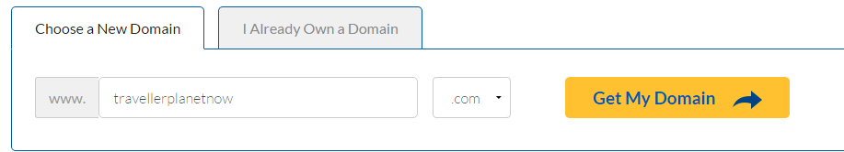
STEP 1 – Sign Up
Hosting 101 Eg. Sign up, create domain
Go to sign up page and register
Then choose a domain for your
website. After which sign up the plan of your
choice
STEP 2 – Create Domain

Slide 17
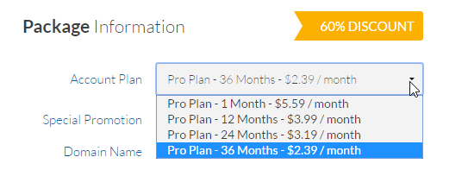
STEP 3 – Select Correct Plan & Sign up
Hosting 101 Eg. Select plan, subscribe
Please choose your plan wisely, if you choose 36months, you may need to pay upfront $2,39*36 = $USD36.
I suggest you sign up for 1 month if its just for this module.. And renew if you need to extend.
But do read the terms and conditions to avoid unnecessary costs.
Sharing will help cut down costs too, but you will need to schedule the uploads.

Slide 18
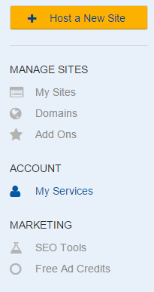
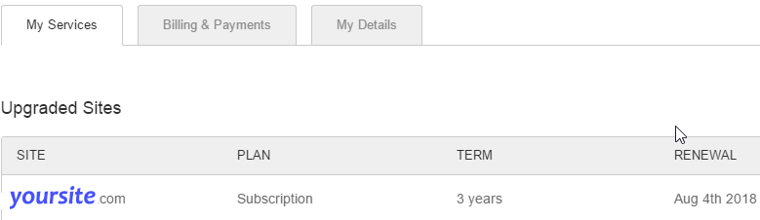
STEP 4 – Login and check your account, subscription and familiarize with the control panel
Hosting 101 Eg. Familiarize with the dashboard / control panel of your host
Click to check on your subscription plans, term, and your details. Browse around the interface and see what services are available to you. Find out where is the section for
  FTP upload
  creating email accounts.
  Access PHPmyadmin

Slide 19
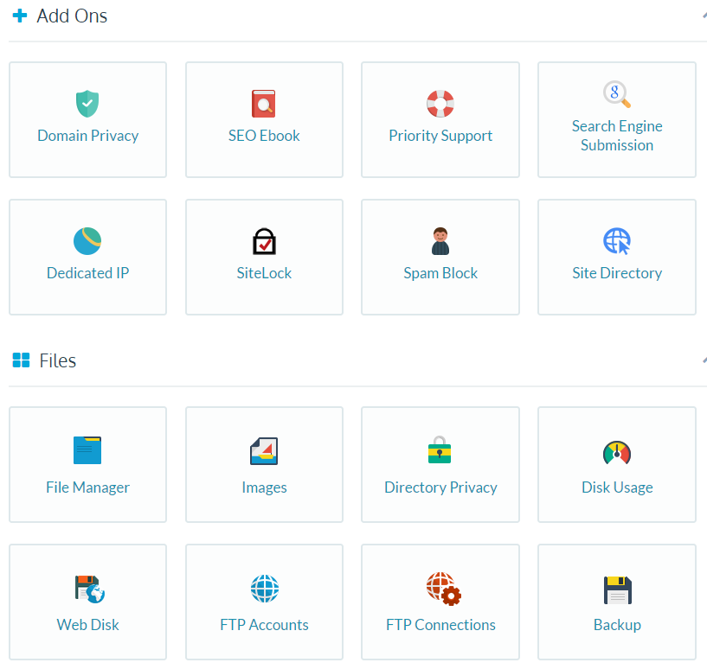
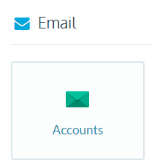
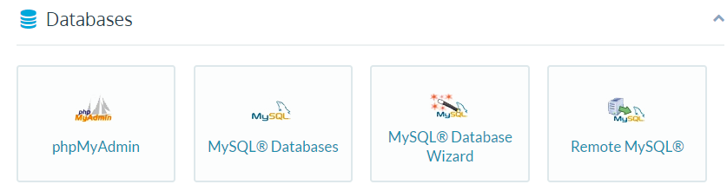
Hosting 101 Eg. The Control Panel
Once you get in, you will be presented with a dashboard of various functions you did use often to manage your website
Highlighted here are some useful functions:
File Manager – Manage your server files (Upload/edit)
FTP Accounts – Create Ftp accounts so that you can upload bulk files using FTP tools (Eg. Filezilla)
MySQL Databases – Create a new database here
phpMyAdmin – Manage your php databasese here / Import data, create table
Accounts – create new email accounts for your admin

Slide 20
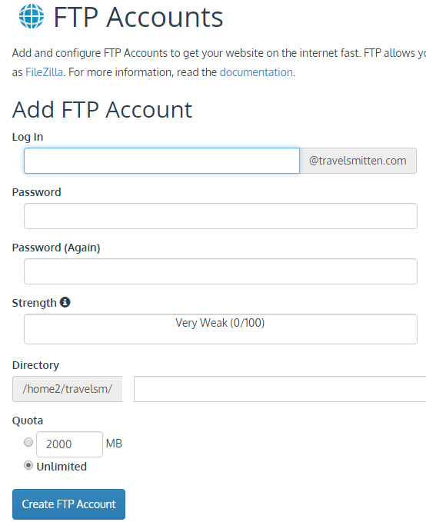
Hosting 101 Eg. Create accounts
STEP 5– Create user account, email addresses
Create as many email address as required
These will be used by your administrators
STEP 6 – Create your FTP accounts
Create an FTP account (In some websites, you are already preassigned an account, in which you may skip this step)
You will need
  Your FTP login name (Username)
  Your password (Password)
  Assign which directory you want to login to
  Know what is the FTP host name (Host)
  This Information will be required for FTP upload, in the next slide.

Slide 21
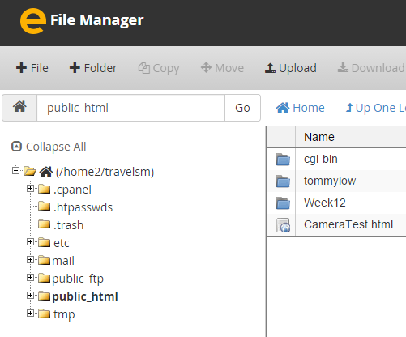

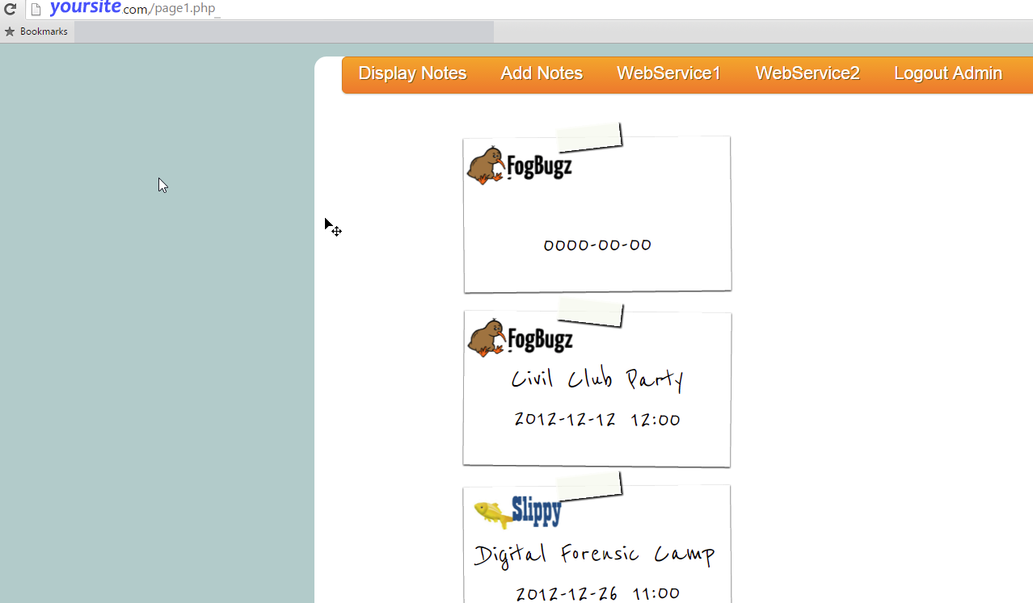
Hosting 101 Eg. Create FTP accounts, and upload
STEP 7– Test out your website via URL
Test out your URL, to see if the files from your website are accessible from your domain URL

Slide 22
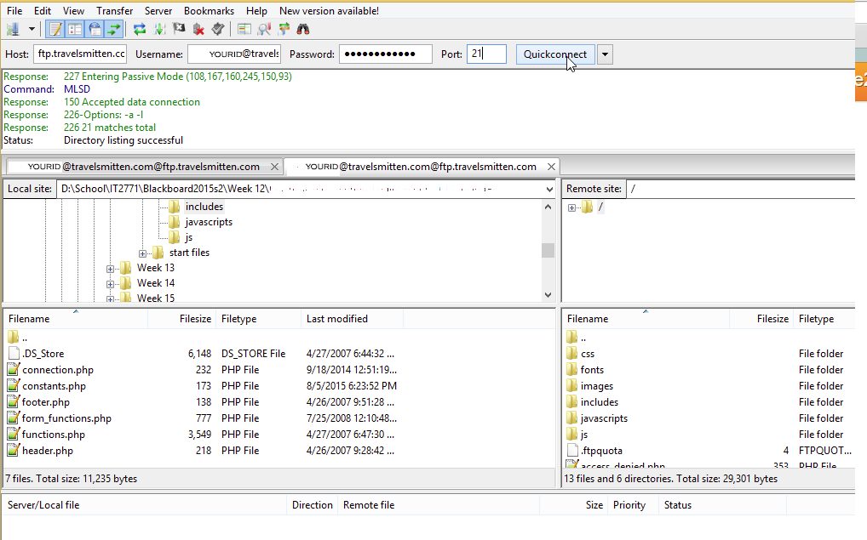
Hosting 101 Eg. Uploading website
STEP 8 – Upload using FTP tool (Filezilla)
1
Key in correct host, username,password and port (if any), then click Quickconnect)
2
3
Once connected, navigate to the correct folder in your hosting server (in the Remote site window)
Drag and down files or folders to the remote window to upload. Always check the status to see if upload is successful
4
Finally, when running your website, always check the error_log file for any errors.

Slide 23
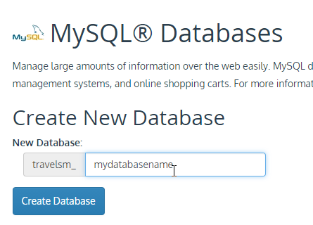
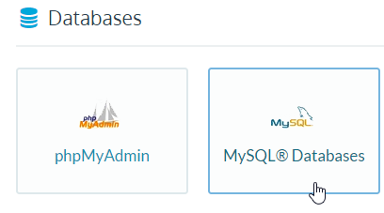
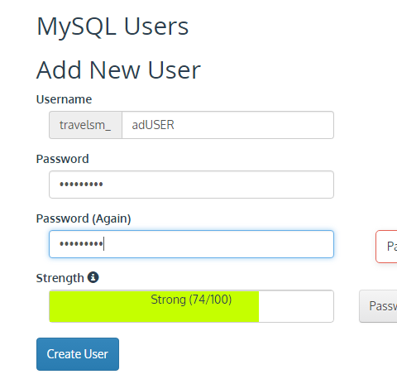
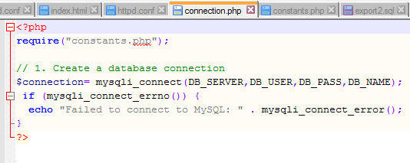
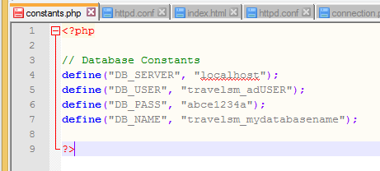
STEP 9 – Create an SQL database
Hosting 101 Eg. Create your database
STEP 10 – Create NEW admin user for your website
Create the superuser and password.
This should correspond to your connection string’s host, user, password & database name
Corresponds

Slide 24
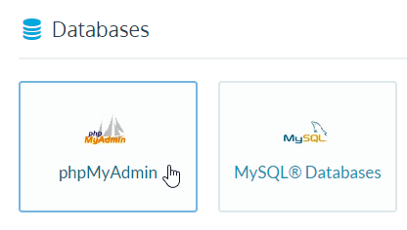
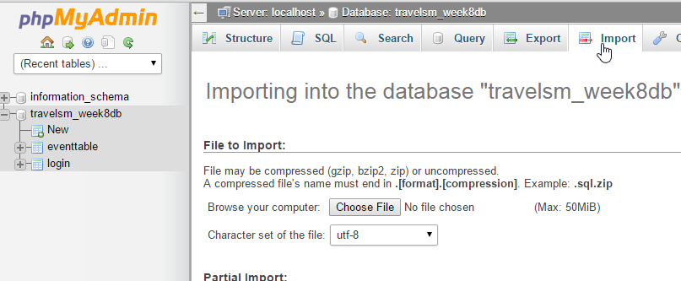
STEP 11 – Upload database design and content via phpMyAdmin
Hosting 101 Eg. Import or Populate your database data & design
Go to the phpMyAdmin from the control panel, and import the .sql files that you have exported from your functioning website previously.

Slide 25
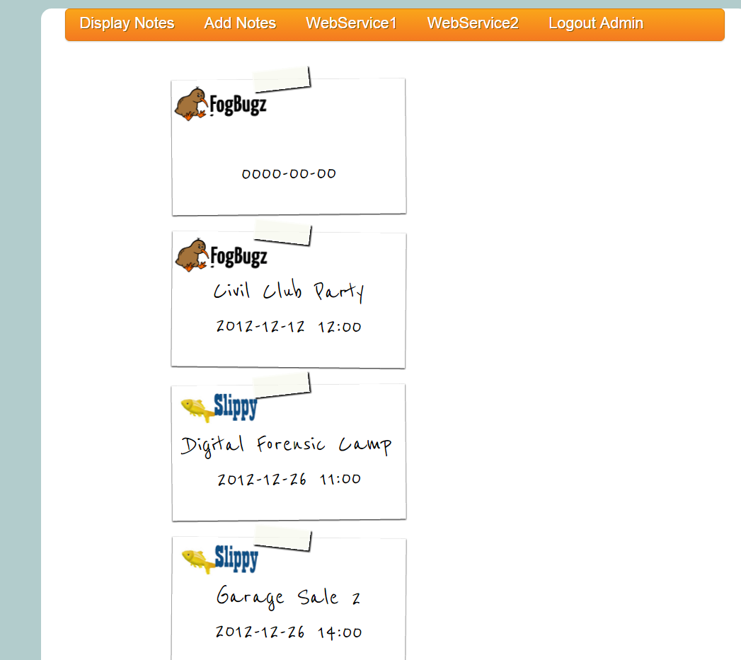
STEP 12 – Test out the entire website with database retrieveal and updates.
Hosting 101 Eg. Testing
If the expected data displays on your website correctly, then congratulations, you have a website up and running, LIVE!

Slide 26
Hosting 101 - Maintenance
You may encounter some errors when you test your website, so do debug and re-upload selected files as necessary.
Also, you will notice that security may be severely lapsed, and your website is easily prone to hacking. So, clean up your website, and secure it. There are plenty of resources online to do that.
You may also explore integrating your site with other useful plugins, and tools provided by your host. For eg. Improving your site visibility through SEOs, Affliate programmes, etc.
Use this as a testbed for your future projects and when you are ready, become an entrepreneur and start a real business for income!

Slide 27
What’s Next
After you get a website, decide on what format your content will be like .
  Use wordpress templates?
  Develop my own website files and upload via ftp?
Next, how do I get traffic into my webpage?
  SEOs, how to make it appear at the first few pages of google search?
  Social media marketing – spread the word through facebook pages, tweeter, forums, pinterest, tumblr, reddit, or pay with youtube ads, google adwords, etc.
  Go to google/youtube, find out more on SEOs, and social media marketing, and be very surprised that you can, with coordinated strategy, increase your website traffic flow through these methods.

